Slide 1
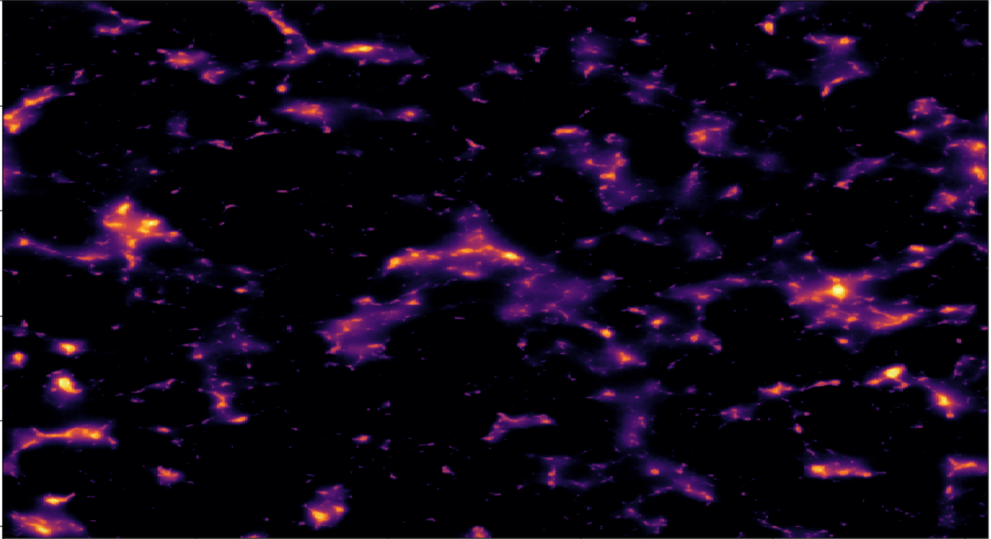





background courtesy of Tyler Cox
Validating the Analysis Pipeline for the
Hydrogen Epoch of Reionization Array
Lily Whitler
Arizona State University
with Steven Murray and the HERA validation team
April 18, 2020
2020 Arizona/NASA Space Grant Symposium

Slide 2
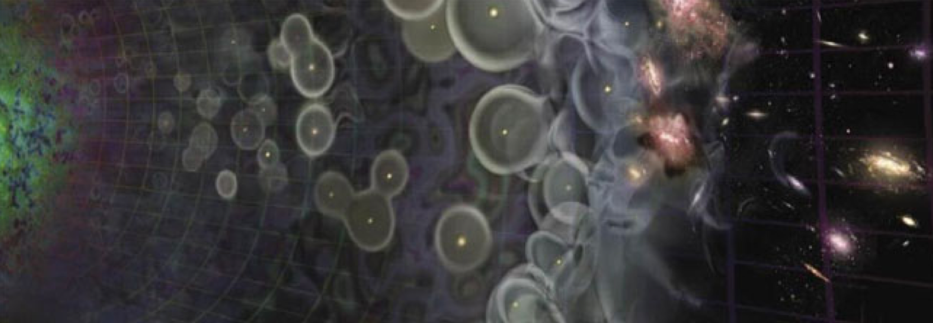
time after Big Bang (*not to scale)
380,000 years
13.7 Gyr
today
CMB
1100
0
Big Bang
redshift, z
now
modified from Loeb+2006
1

Slide 3
time after Big Bang (*not to scale)
380,000 years
13.7 Gyr
today
CMB
Epoch of
Reionization (EoR)
1100
0
Big Bang
redshift, z
now
modified from Loeb+2006
1

Slide 4
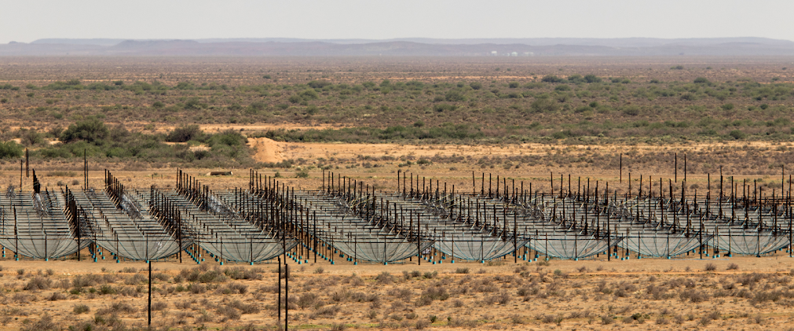
The Hydrogen Epoch of Reionization Array (HERA) is
designed to study the EoR via the redshifted 21 cm line...
2

Slide 5
...requiring precision of
1 in 100,000
at every step
3

Slide 6
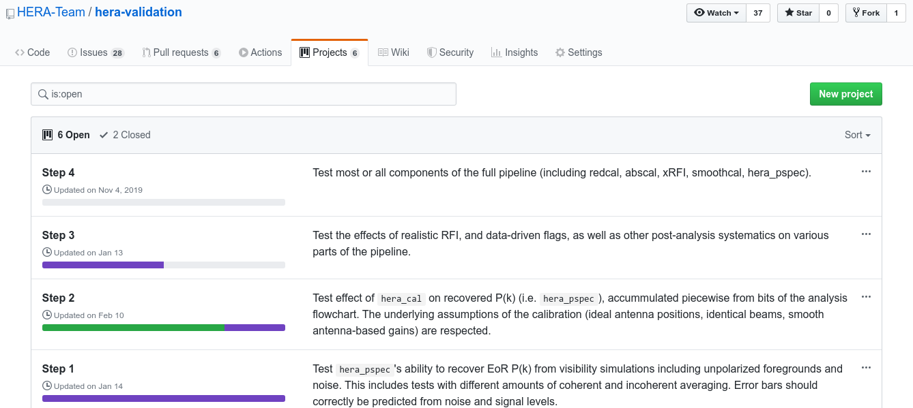
Validating the software is a crucial step
for us to trust the results of the analysis
(and there is an entire team dedicated to it)
4

Slide 7
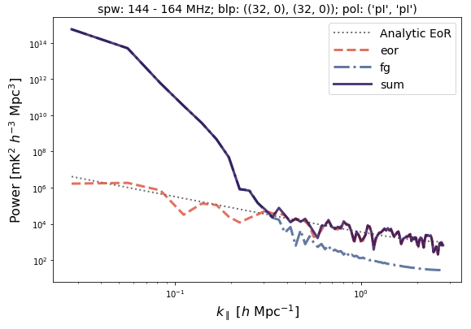
Validation starts with simple tests and
builds to more complex analysis steps
10 minutes of simulated data
EoR signal +
point source foregrounds
5

Slide 8
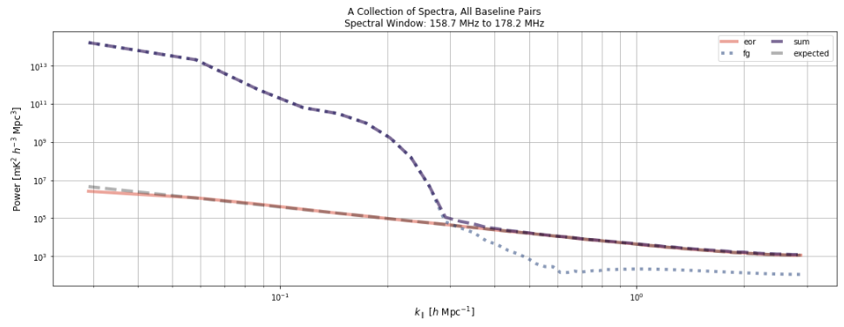
With just the EoR and foregrounds, the
pipeline performs as expected...
8 hours of simulated data, EoR signal + point source foregrounds
6

Slide 9
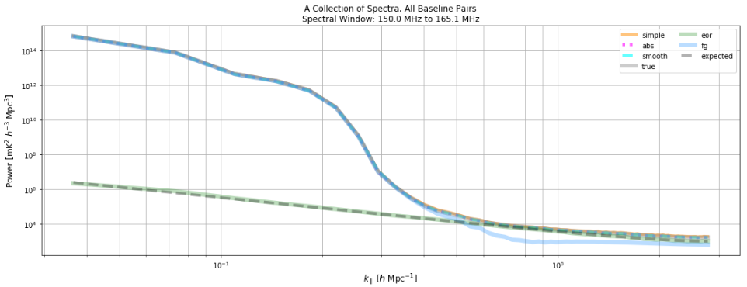
...as well as with calibration
courtesy of Bobby Pascua
8 hours of simulated data, EoR signal + point source foregrounds + calibration
7

Slide 10
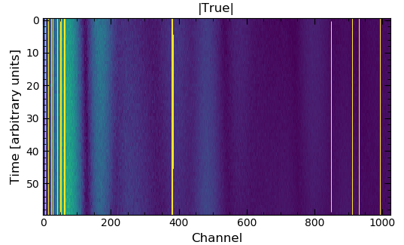
Next step: test removal of radio frequency interference (RFI)
8

Slide 11
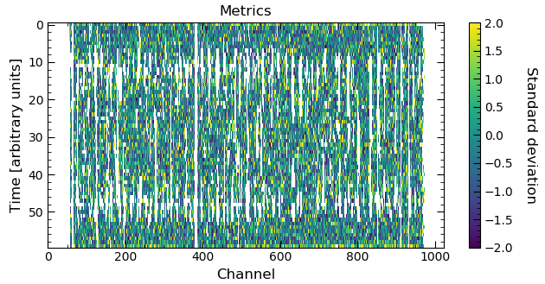
Current status: RFI excision algorithm does
not perform well on simulated data
9

Slide 12
Summary
Validating the analysis software is
critical for trusting our results
Recovered power spectra match the analytic input
within 1% for simulated EoR signal and foregrounds
Calibrated power spectra match the
true power spectra within 0.1%
RFI excision fails on simulated data, which
will be investigated in the future
10

